Slide 1
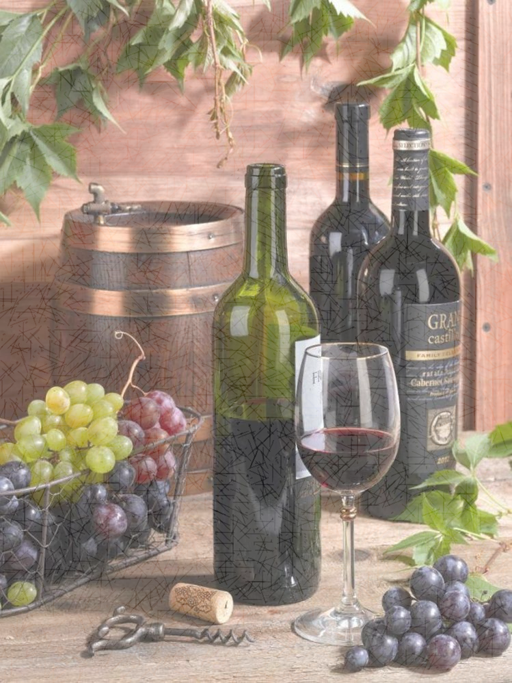
WINE QUALITY PREDICTION
Under the Guidance of
Professor Syed Jawad Shah
Done By Group UNIQUE
Vijayeshwari Palakurthi
Nimisha Chunduru
Chanikya Atluri
Pravalika Muppalaneni

Slide 2
INTRODUCTION
For both the customer and the wine-making businesses, the wine's quality is a crucial factor. Using product quality certification, industries are expanding their sales.
Each person has a unique perspective on the test, therefore judging the wine's quality based on the opinions of humans is difficult. Numerous factors can be used to forecast wine quality, however not all factors will be effective in making a more accurate prediction.
The research uses the wine quality dataset and machine learning classification techniques like Support Vector Machine (SVM), Naive Bayes (NB), and Artificial Neural Network (ANN) to determine what wine features are crucial to obtaining a good outcome.

Slide 3
ABSTRACT
It has not yet been possible to quantify the importance of each factor for predicting wine quality. Additionally, the accuracy is currently at 67.25% in terms of performance.
Thus, we focused on two issues in our thesis:
To the investigation of the significance of the characteristics for the assessment of wine quality.
To utilize a neural network to enhance the performance of the prediction model.
The following goals are established to answer the study question:
For the dataset's balance.
To evaluate how the characteristics have an effect.
To tune the hyperparameters in the classification models for maximum performance.
To evaluate the methods and model them.

Slide 4
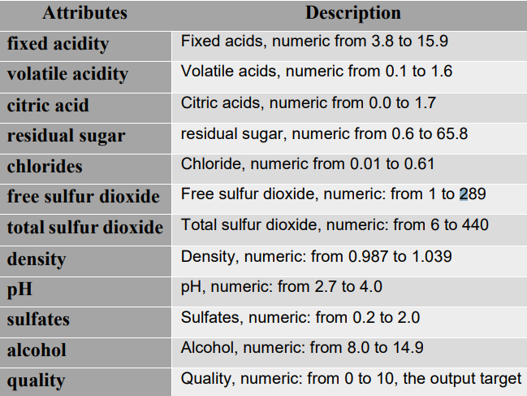
To Balance the dataset
We utilized the red wine and white wine datasets from the UCI machine learning repository, which houses a sizable collection of datasets that have been used by the machine learning community. Two excel files, one each for red wine and white wine, are included in the dataset. There are 1599 examples of red wine in the red wine dataset and 4898 instances of white wine in the white wine dataset. There are 11 input variables in each dataset.

Slide 5
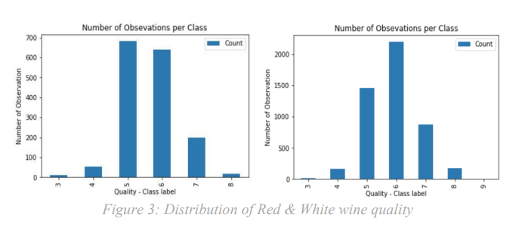
UNBALANCED DATASET

Slide 6
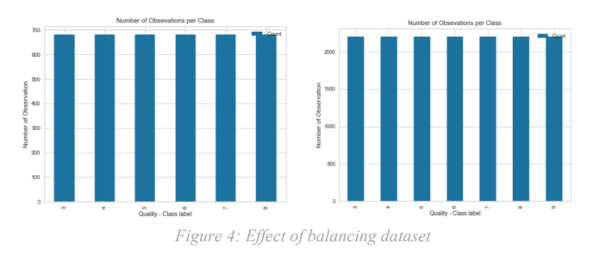
BALANCED DATASET USING SMOTE

Slide 7
Feature selection
The process of choosing the optimal subset of characteristics to be utilized for classification is known as feature selection.
Feature selection is also used to explore the link between the features , to gain a better understanding of the features and to determine the correlation between the features, we use the Pearson coefficient correlation matrices.

Slide 8
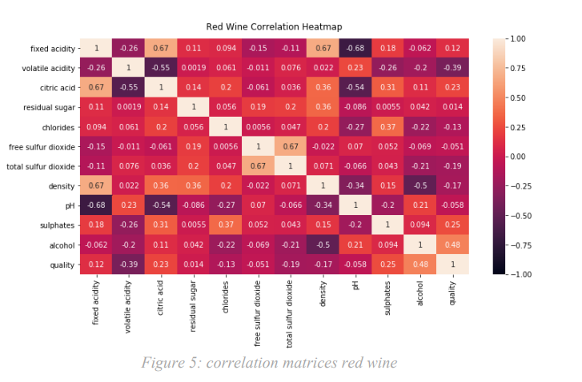
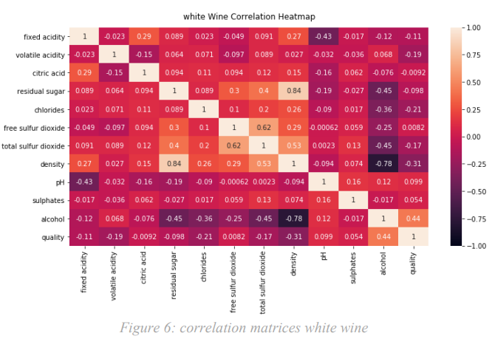

Slide 9
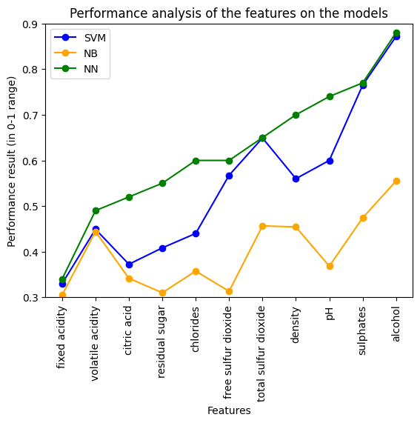
Results of feature selection

Slide 10
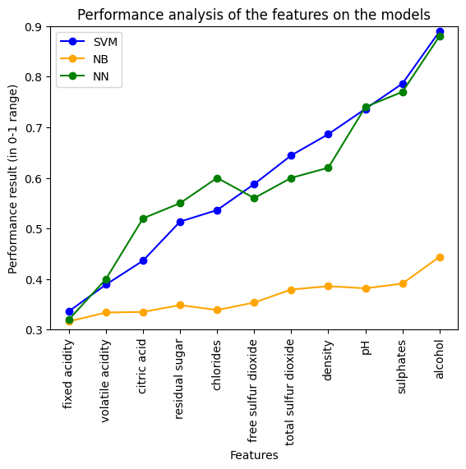

Slide 11
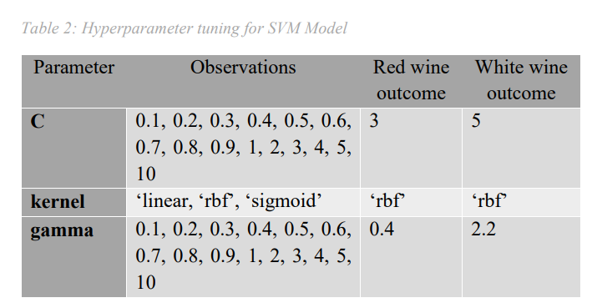
hyperparameter tuning
Hyperparameters, the quantity of observations, and the results of each observation were employed to enhance the performance of the support vector machine model.

Slide 12
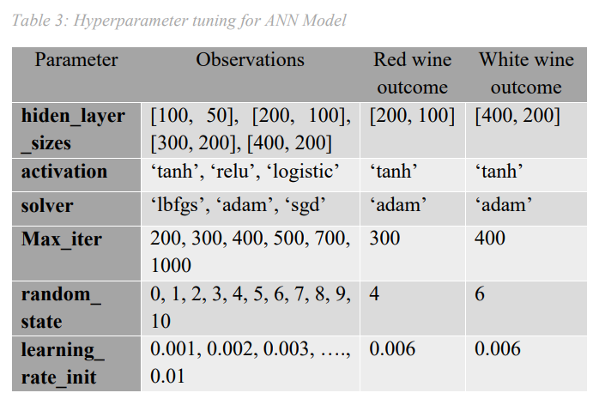
Similar to this, we employed the hyperparameters, the quantity of observations, and the results of each observation, as shown in Table 3, to enhance the performance of the artificial neural network model.

Slide 13
evaluation of the models
Techniques we use for the evaluation of the model are:
Accuracy
Precision
Recall
F1 score
For the majority of traditional applications, accuracy is the most often utilized evaluation metric.
The F1 score combines the precision and recall matrices. Precision describes how well the model predicted a certain class, while recall describes the reverse of frequently misplaced cases that are incorrectly categorised.

Slide 14
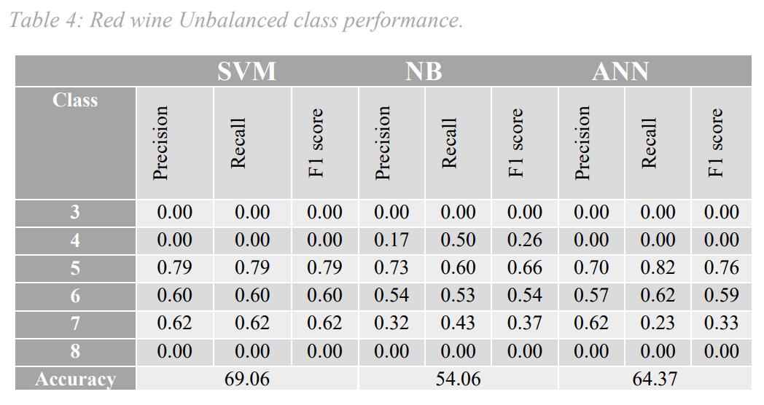
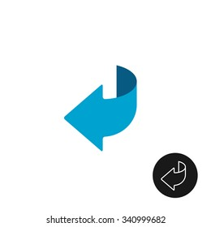
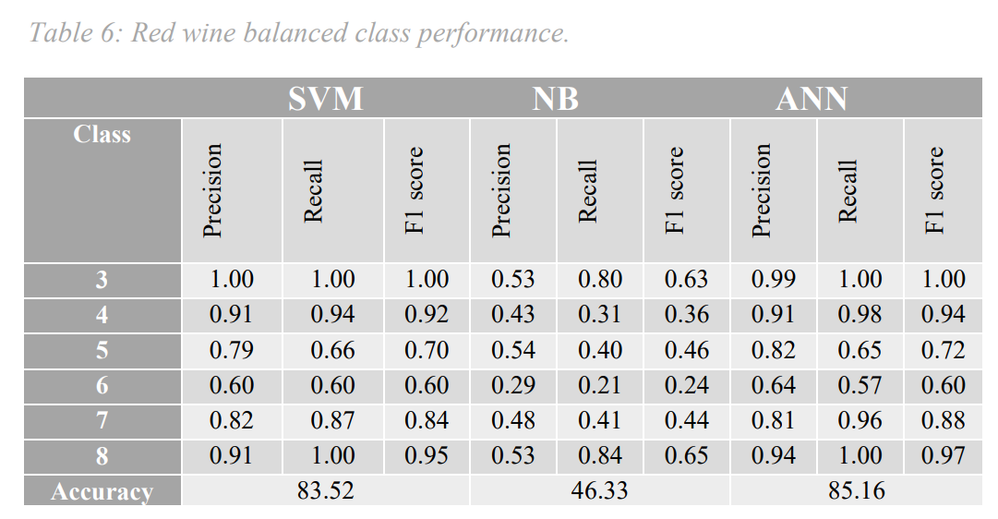
RED WINE
Unbalanced Class
Balanced Class
Accuracy has increased
Model | Unbalanced | Balanced
SVM | 69.06 | 83.52
NB | 54.06 | 56.33
ANN | 64.37 | 85.16

Slide 15
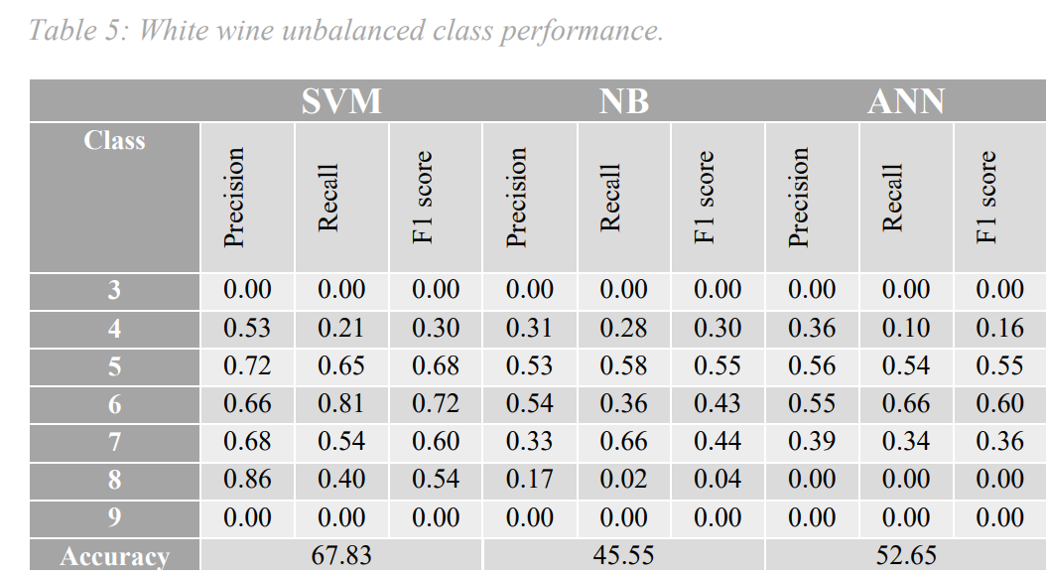
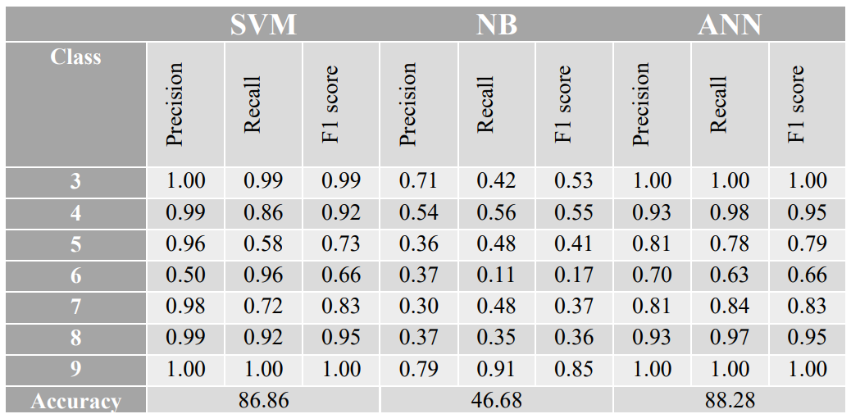
WHITE WINE
Unbalanced Class
Balanced Class
Accuracy has increased
Model | Unbalanced | Balanced
SVM | 67.83 | 86.86
NB | 45.55 | 46.68
ANN | 52.65 | 88.28

Slide 16
FINAL RESULTS
Using Pearson coefficient correlation matrices, the traits that can produce superior prediction results were found. The model's performance is enhanced after the sample datasets, which are balancing datasets, are applied.
The accuracy of the naive Bayes (NB) algorithm is 46.33% from the red wine and 46.68% from the white wine, while the support vector machine (SVM) algorithm's accuracy from the red wine and white wine is 85.16% and 86.86%, respectively. The accuracy of the artificial neural network (ANN) algorithm is 85.16% and 88.28%, respectively.

Slide 17
CONCLUSION
The model's performance is enhanced after the sample datasets, which are balancing datasets, are applied. In general, the classification model performed better when unnecessary features from the datasets were removed.
On both the red and white wine datasets, we found that the artificial neural network (ANN) produced the greatest accuracy results among these three machine learning algorithms.
As a result, picking the suitable features and balancing the data in the classification algorithms might enhance the performance of the prediction model.

Slide 18
THANK YOU
Team UNIQUE

